Slide 1
The RFID Ecosystem Project
Longitudinal Study of a Building-Scale RFID Ecosystem
Evan Welbourne with Karl Koscher, Emad Soroush, Magdalena Balazinska, Gaetano Borriello
University of Washington, CSE MobiSys 2009 June 22, 2009 - Kraków, Poland

Slide 2
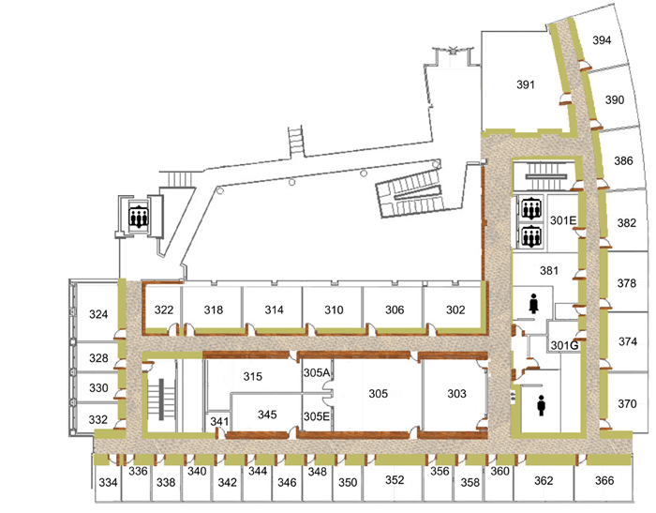
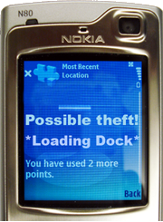
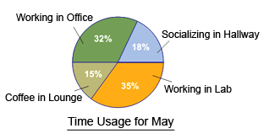
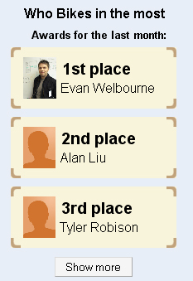
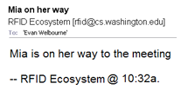
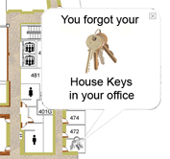
Focus: Pervasive RFID Systems
http://rfid.cs.washington.edu/
RFID tags on people and objects
Higher-level events are inferred
RFID Trace:
tag | Antenna | Time
Bob, notes | C | 1
Bob, notes | B | 4
Bob, notes | A | 6
… | … | …
“Working in Office”
Notes:
2

Slide 3
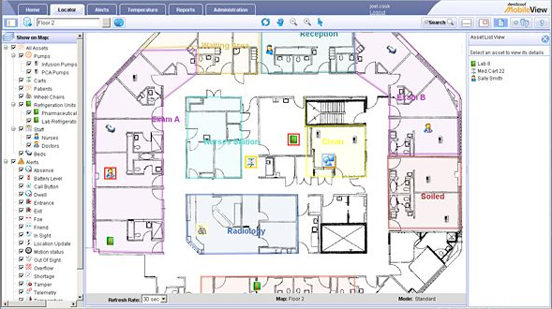
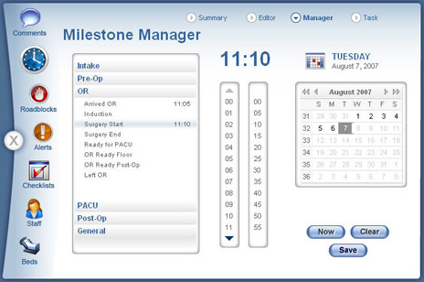
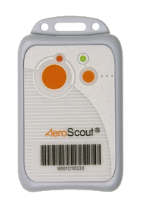
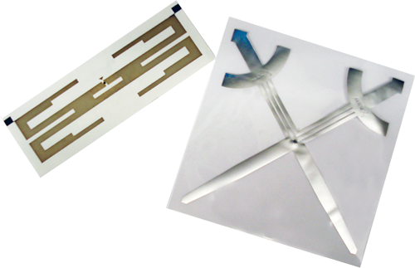
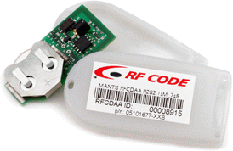
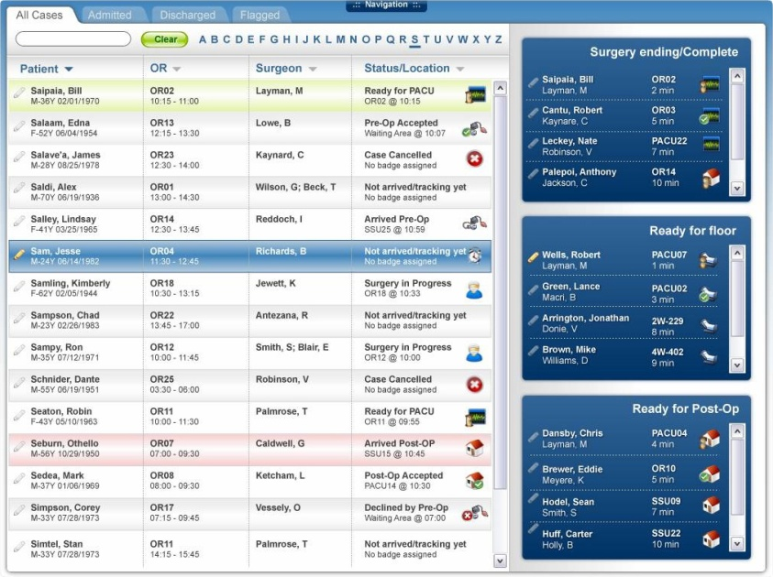
Focus: Pervasive RFID Systems
http://rfid.cs.washington.edu/
RFID tags on people and objects
Higher-level events are inferred
High-performance passive tags
EPC Gen 2 tags
What does the data from a pervasive system look like?
How well do the tags perform?
Can performance be improved?
Will users adopt passive RFID tags?
Do users accept applications built on passive RFID?
Past studies are limited to lab-like settings…
VS.
[ http://www.aeroscout.com]
Track Hospital’s Equipment, Staff
[ http://www.pcts.com]
Detect Care Milestones
Active Tags
Passive Tags
Battery-powered
$10 - $100 (US)
Reliable location stream
No batteries
< $1 (US)
Less reliable location
[ http://www.pcts.com]
Notes:
3

Slide 4
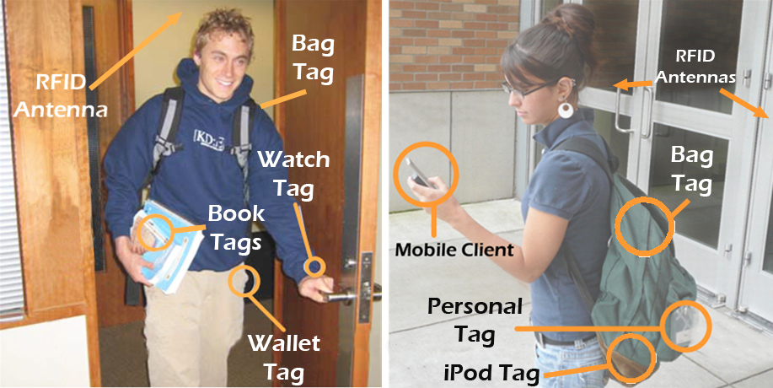
Longitudinal Study
4-week study of a building-scale RFID deployment:
EPC Gen 2 RFID
67 participants
300+ tags
Location apps
Summary:
1.5M tag reads
38,000 antenna visits
9 lost or broken tags
9,000 application operations by participants
0 reported privacy breaches
Notes:
4

Slide 5
Outline
Deployment overview
Data rates and system load What does the data from a pervasive system look like?
Tag Performance How well do passive tags perform in practice?
Probabilistic Inference Can performance be improved in software?
End-user tag management Will users adopt passive tags?
Applications Do users accept applications based on passive RFID?
Notes:
5

Slide 6
Outline
Deployment overview
Data rates and system load What does the data from a pervasive system look like?
Tag Performance How well do passive tags perform in practice?
Probabilistic Inference Can performance be improved in software?
End-user tag management Will users adopt passive tags?
Applications Do users accept applications based on passive RFID?
Notes:
6

Slide 7
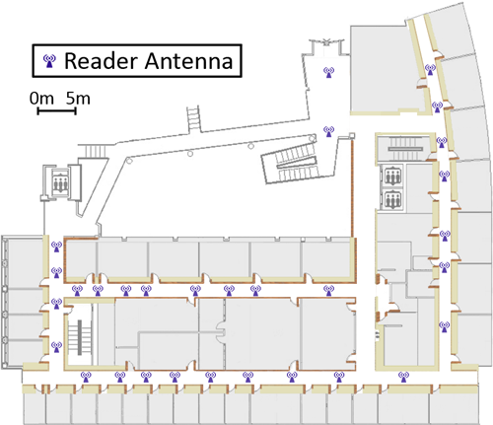
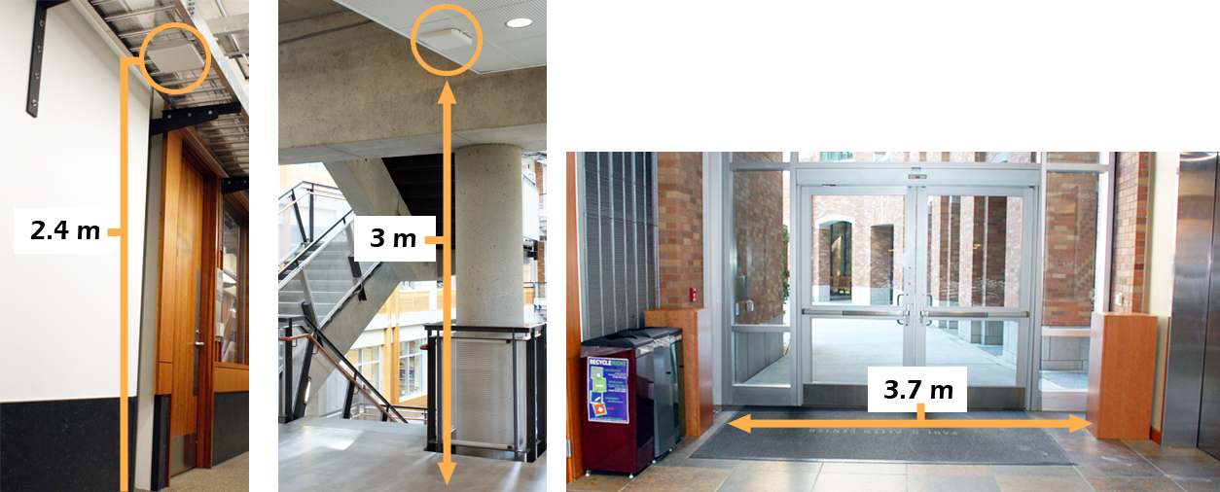
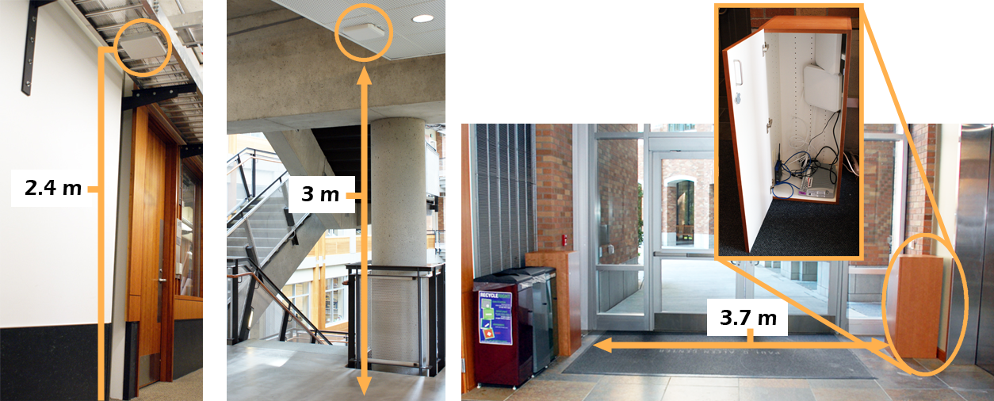
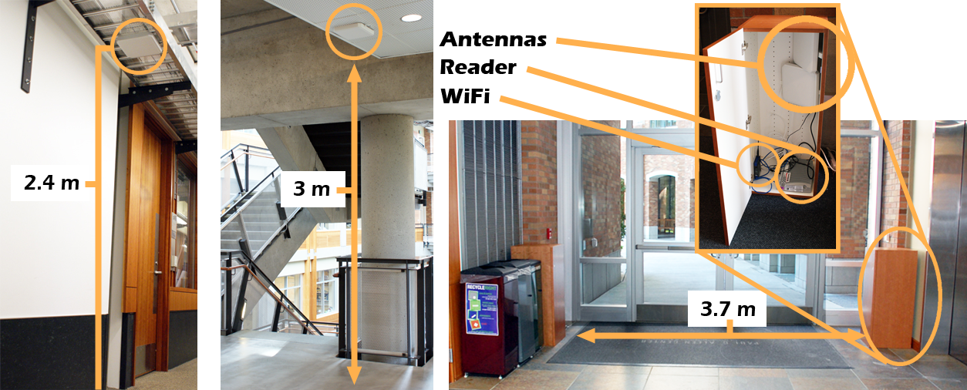
The RFID Ecosystem
CSE Building (8,000 m²)
47 Readers, 160 Antennas
Installed in 3 configurations
First Floor Entrance
(not shown on map)
Notes:
7

Slide 8
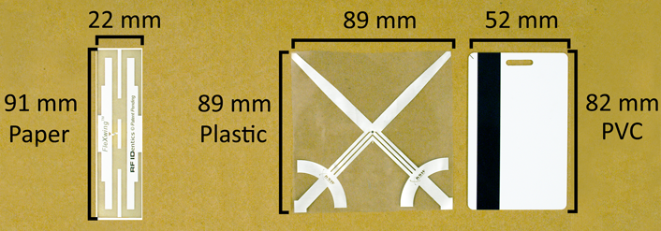
RFID Tags
Three tag designs
324 tags on 19 types of objects:
Personal Badges
Bags
Clothing
Keys
Wallets, Purses
Books
Paper, binders
iPods, Laptops, Phones
Food / Water Containers
And more…
Notes:
8

Slide 9
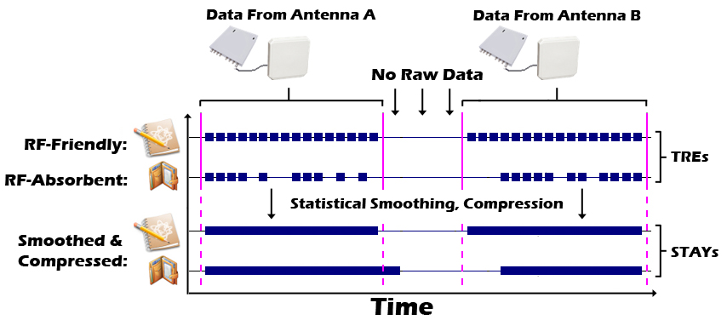
RFID Data Streams
Tag Read Events (TREs) and STAYs
TRE: (tag, antenna, time)
STAY: (tag, antenna, start time, stop time)
Example:
Notes:
9

Slide 10
Outline
Deployment overview
Data rates and system load What does the data from a pervasive system look like?
Tag Performance How well do passive tags perform in practice?
Probabilistic Inference Can performance be improved in software?
End-user tag management Will users adopt passive tags?
Applications Do users accept applications based on passive RFID?
Notes:
10

Slide 11
Outline
Deployment overview
Data rates and system load What does the data from a pervasive system look like?
Tag Performance How well do passive tags perform in practice?
Probabilistic Inference Can performance be improved in software?
End-user tag management Will users adopt passive tags?
Applications Do users accept applications based on passive RFID?
Notes:
11

Slide 12
Data Rates and System Load
Unlike supply chain RFID applications… Amount of data generated is very manageable
Total raw data: 53 MB → Compresses to: 1 MB
Peak Rate: 8400 TRE / hour
Scale to 1M tags: ~ 100 MB / day
Explanation:
Fewer tags than in the supply chain
No antennas inside offices
Many tagged objects never move
Supply chain numbers may not be compressed
Notes:
12

Slide 13
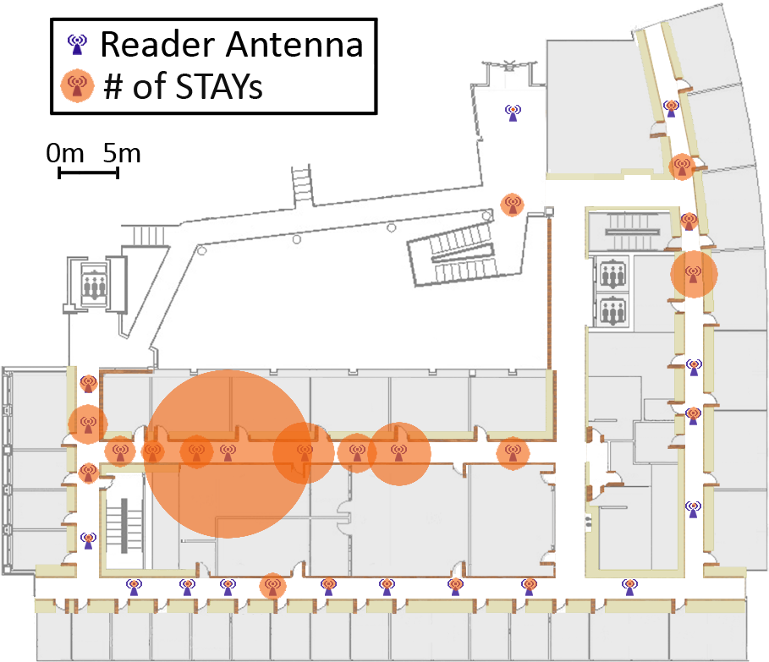
Data Rates and System Load
Like similar studies in wireless mobility… Load mirrors patterns of building occupancy
US Veteran’s Holiday
US Thanksgiving Holiday
“Hot spot” antennas:
Outside research lab
Outside student store
Major Undergrad Project Due
Implications:
Makes sense to allocate more resources to hot spots
Predictable off-peak times for batch processing
Notes:
13

Slide 14
Outline
Deployment overview
Data rates and system load What does the data from a pervasive system look like?
Tag Performance How well do passive tags perform in practice?
Probabilistic Inference Can performance be improved in software?
End-user tag management Will users adopt passive tags?
Applications Do users accept applications based on passive RFID?
Notes:
14

Slide 15
Outline
Deployment overview
Data rates and system load What does the data from a pervasive system look like?
Tag Performance How well do passive tags perform in practice?
Probabilistic Inference Can performance be improved in software?
End-user tag management Will users adopt passive tags?
Applications Do users accept applications based on passive RFID?
Notes:
15

Slide 16
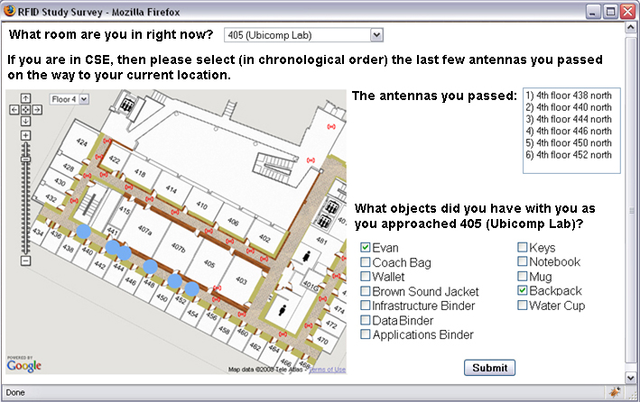
Tag Performance
1358 web-surveys collected ground truth location data
We compute Detection-Rate:
Probability that a tag is detected by a nearby antenna
Notes:
16

Slide 17
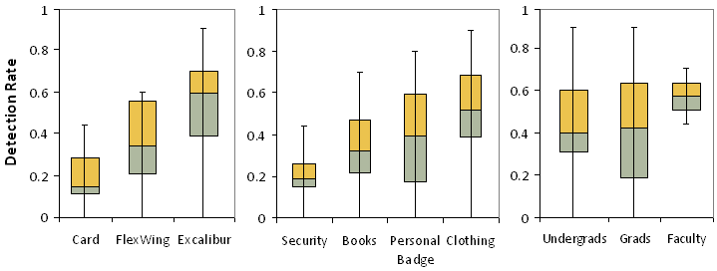
Tag Performance
Compared to performance in controlled laboratory studies… Performance was significantly worse
Key Factors:
1) Tag design
2) Object type
3) Mounting
Implications:
Must cope with high uncertainty in raw data
Performance engineering opportunities:
Larger antennas work better
High variance: Differences in tag mounting (Also slight differences in material composition)
All lower than detection rate in lab studies
Other factors: simultaneous mobile tags, RF interference,…
ex: wallet, purse, keys
More RF-absorbent
Tags held tight against body
ex: bag, hat, helmet, jacket
Less RF-absorbent
Tags more separated from body
Best design
Better mounting
Redundancy*
Notes:
17
Mention multi-tagging?

Slide 18
Outline
Deployment overview
Data rates and system load What does the data from a pervasive system look like?
Tag Performance How well do passive tags perform in practice?
Probabilistic Inference Can performance be improved in software?
End-user tag management Will users adopt passive tags?
Applications Do users accept applications based on passive RFID?
Notes:
18

Slide 19
Outline
Deployment overview
Data rates and system load What does the data from a pervasive system look like?
Tag Performance How well do passive tags perform in practice?
Probabilistic Inference Can performance be improved in software?
End-user tag management Will users adopt passive tags?
Applications Do users accept applications based on passive RFID?
Notes:
19

Slide 20
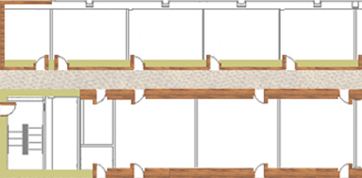
Probabilistic Inference
To further improve performance on top of uncertain RFID data… Probabilities help, must be applied with care
Tackle inherent uncertainty of event detection as well
Approach:
Probabilistic model of location w/particle filter
Process with probabilistic event detection engine
Evaluation: “Entered-Room” using survey results
Despite high uncertainty:
60% correct room, 80% correct vicinity
But doesn’t work when detection rate < 0.5
Probabilistic data is computationally expensive
?
?
?
?
Notes:
20

Slide 21
Outline
Deployment overview
Data rates and system load What does the data from a pervasive system look like?
Tag Performance How well do passive tags perform in practice?
Probabilistic Inference Can performance be improved in software?
End-user tag management Will users adopt passive tags?
Applications Do users accept applications based on passive RFID?
Notes:
21

Slide 22
Outline
Deployment overview
Data rates and system load What does the data from a pervasive system look like?
Tag Performance How well do passive tags perform in practice?
Probabilistic Inference Can performance be improved in software?
End-user tag management Will users adopt passive tags?
Applications Do users accept applications based on passive RFID?
Notes:
22

Slide 23
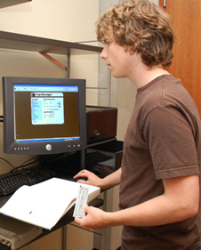
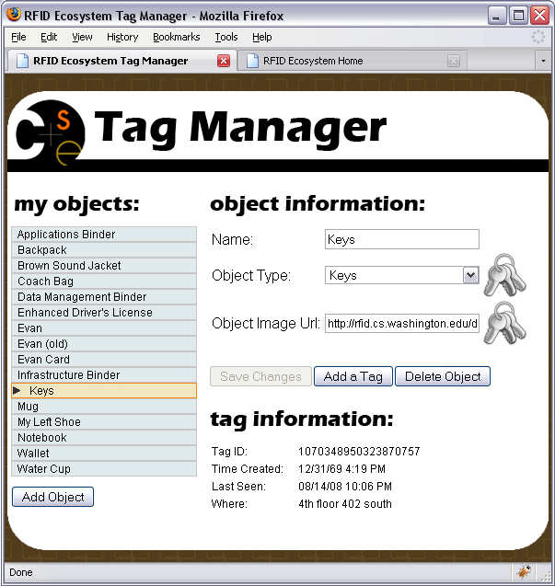
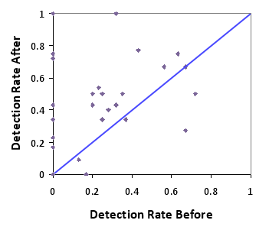
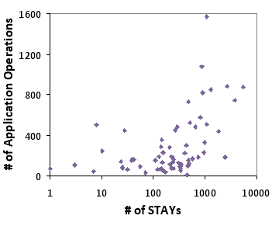
End-User Tag Management
To encourage optimal tag performance… Tag use must be supported and incentivized
Participants mounted & managed their own tags
Only basic guidelines and reminders for 3 weeks
Experts remounted poorly performing tags in week 4
Exit survey for 67 participants also showed:
41 often forgot to carry tags
8 found tags socially awkward to carry/wear
19 said tags were inconvenient or uncomfortable
9 tags reported lost or broken
Notes:
23

Slide 24
Outline
Deployment overview
Data rates and system load What does the data from a pervasive system look like?
Tag Performance How well do passive tags perform in practice?
Probabilistic Inference Can performance be improved in software?
End-user tag management Will users adopt passive tags?
Applications Do users accept applications based on passive RFID?
Notes:
24

Slide 25
Outline
Deployment overview
Data rates and system load What does the data from a pervasive system look like?
Tag Performance How well do passive tags perform in practice?
Probabilistic Inference Can performance be improved in software?
End-user tag management Will users adopt passive tags?
Applications Do users accept applications based on passive RFID?
Notes:
25

Slide 26
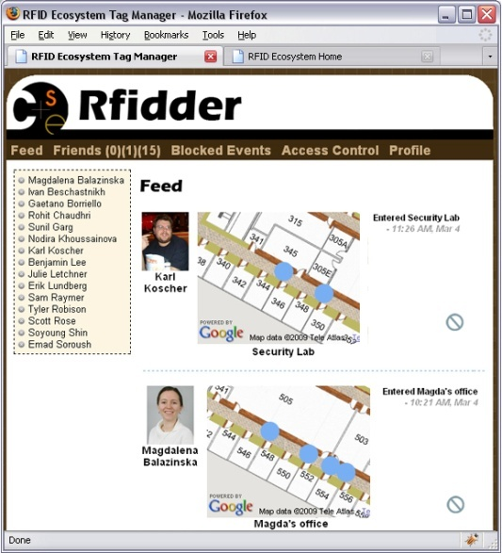
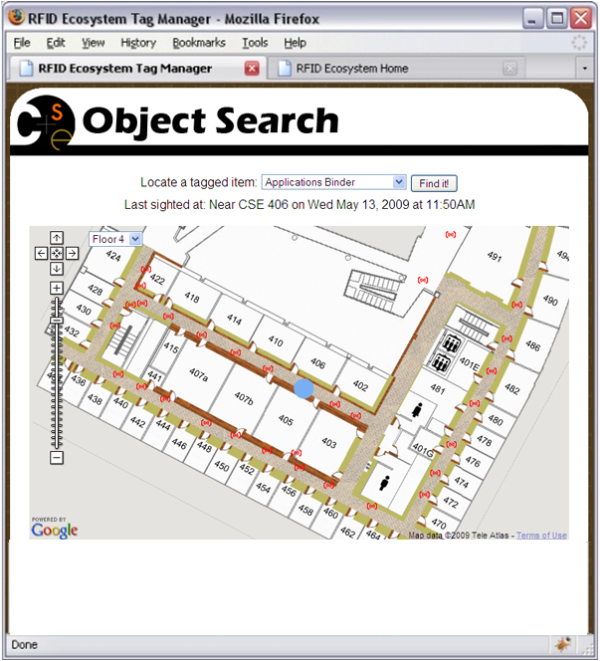
Applications
Standard location-aware applications
Built using Cascadia system (MobiSys 2008)
Event detection over deterministic raw data
Notes:
26

Slide 27
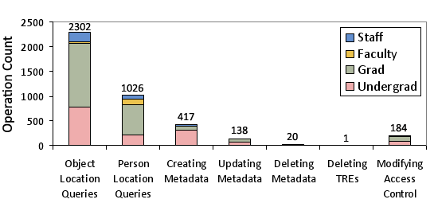
Applications – Privacy
Contrary to expectation…
Very few participants concerned w/personal privacy
Tool for deleting data was used “only as a test”
Relatively few operations to manage privacy
Many said: “Not concerned about tracking in CSE” “More concerned about employer or gov’t”
Only 7 participants removed tags for privacy reasons
12 reported behavior change (e.g., arriving earlier)
0 reported privacy breaches
[See IEEE Pervasive 07, Internet Computing 09 for more on privacy]
Notes:
27

Slide 28
Applications - Adoption
Applications were “novel, fun, useful” depending on…
Ease of use, participating friends, tag performance
Exit-survey for 67 participants showed:
Most found apps novel, fun; 15 found them truly useful
Barriers: log-in (18), lack of friends (15), poor tags (5)
Requested features:
Push-based interfaces (Desktop Feed gadget)
More complex events, historical data (“Digital Diary”)
Future Work:
Push information to users rather than pull
Support more complex events, historical queries
Notes:
28

Slide 29
Summary
Through longitudinal study in a pervasive deployment:
Data rates and system load are quite manageable
Tag performance worse than in lab but there’s hope
Probabilistic inference helps but must be applied w/care
End-users need substantial support in mounting tags, applications are a good incentive
Users accept applications (when they work), but more sophisticated functionality is desired
Conclusion:
Pervasive computing with passive RFID is feasible but extensive optimizations are required
Notes:
29

Slide 30
Thank you!
See our website for more information:
http://rfid.cs.washington.edu/
http://rfid.cs.washington.edu/publications.html

Slide 31
Backup Slides
Backup Slides…
Notes:
31

Slide 32
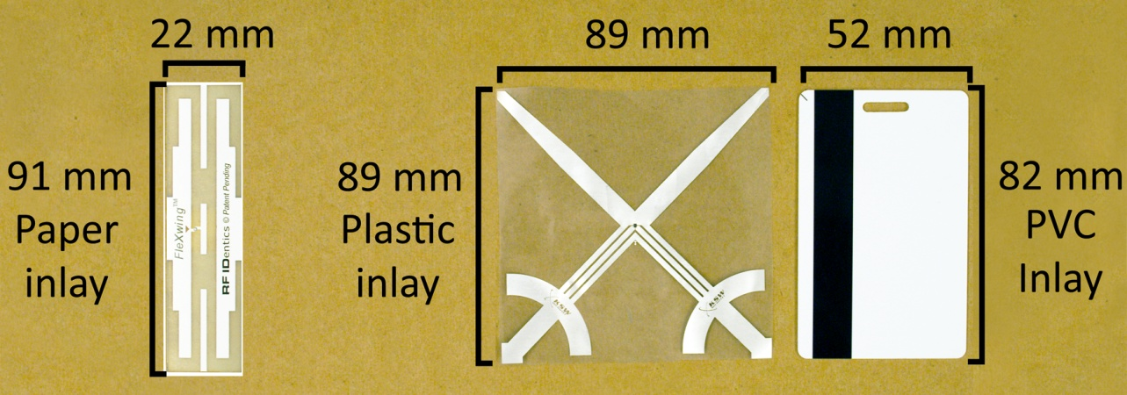
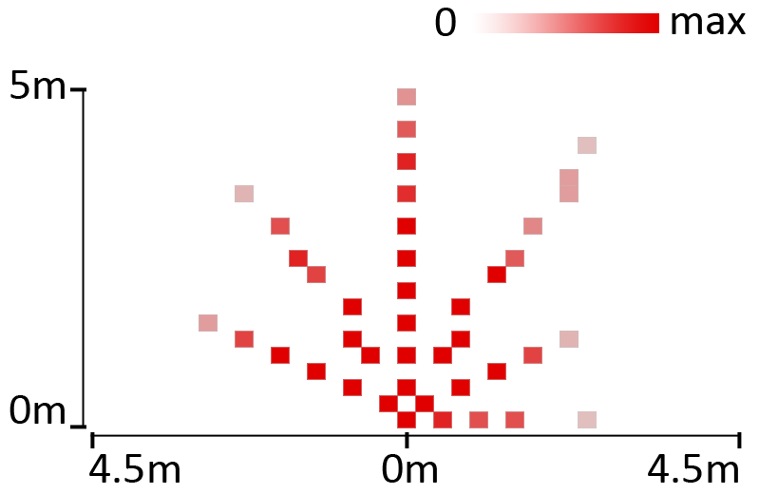
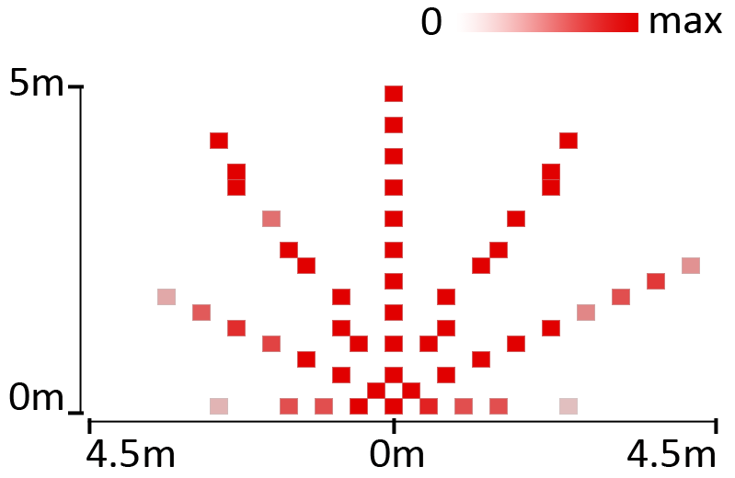
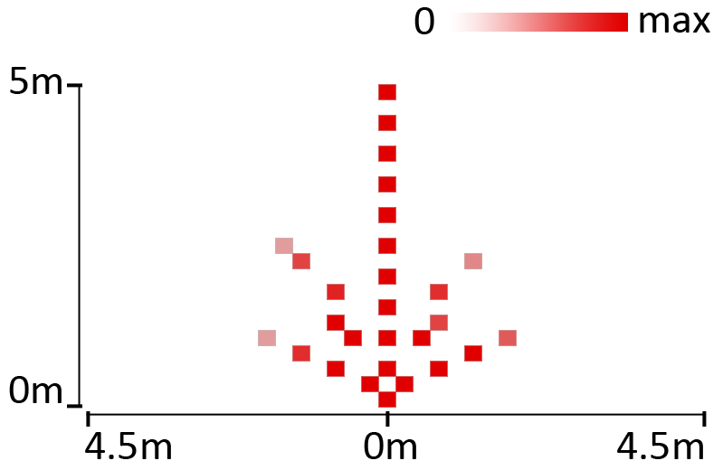
EPC Gen 2 RFID Equipment
3 types of tags:
Lab benchmarks showing read-rate:
FleXwing
Excalibur
PVC Card
Notes:
32

Slide 33
Recruiting Participants
Email sent to Faculty, Staff, grads, undergrads
$30 for participation
+ $10 for completing >= 25% of surveys
+ $20 for completing >= 50% of surveys
Recruited Participants
Faculty Participants | 2
Staff Participants | 2
Grad Participants | 30
Undergrad Participants | 33
MALE | 46
FEMALE | 21
Notes:
33

Slide 34
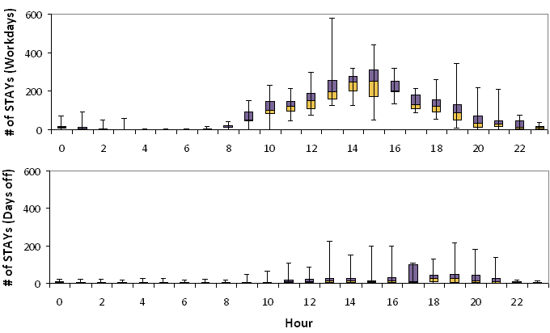
Hourly Data Rates
Total:
1.5M TREs
38K STAYs
Max Rate:
8408 TRE/hr
601 STAY/hr
Min Rate:
0 TRE/hr
0 STAY/hr
Notes:
34

Slide 35
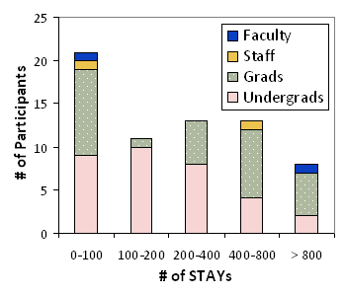
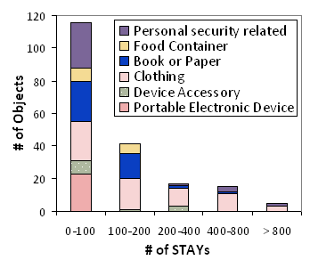
People and Objects
Participants: Almost no data or a lot of data
Some forgot tags often; Some not in bldg
Objects: Same trend
Mobility of object; Material of object
Notes:
35

Slide 36
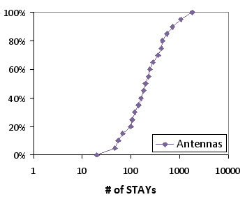
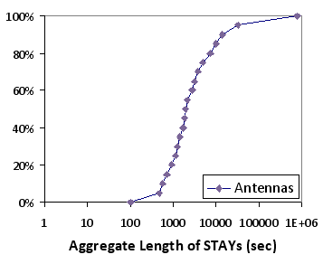
Load Distribution
Some antennas are “hot spots”
Similar to wifi mobility studies
Notes:
36

Slide 37
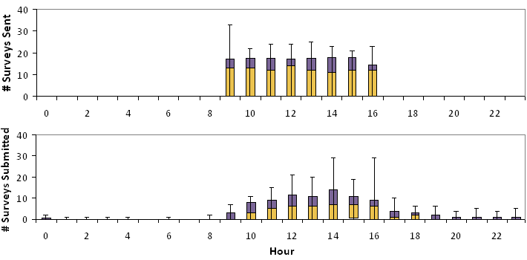
Survey Responses
2226 Surveys Sent, 1358 Received
18 seconds to complete (avg)
Notes:
37

Slide 38
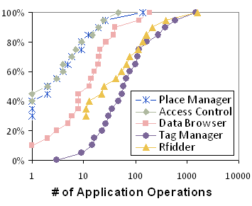
Application Usage
Usage varies by participant
0.37 correlation: data generated and app usage
Notes:
38

Slide 39
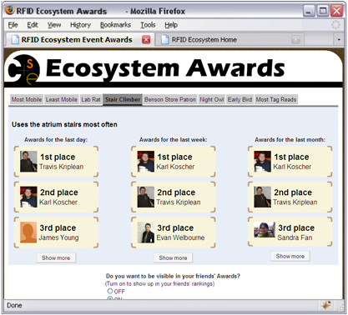
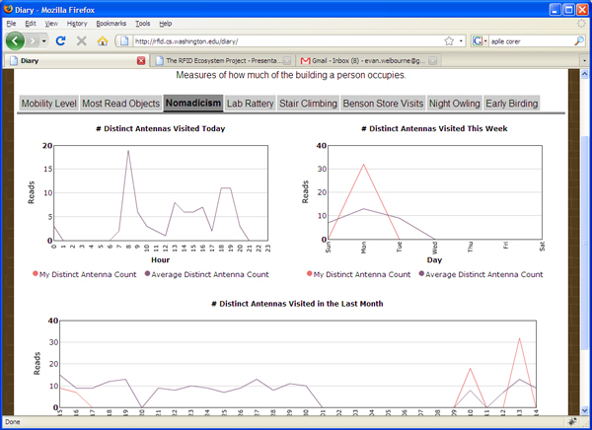
More Recent Applications
Use Historical Data
View Trends
Notes:
39

Slide 40
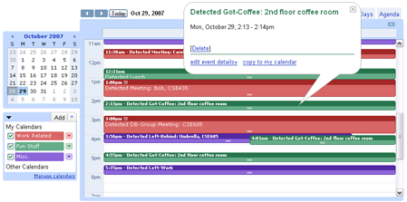
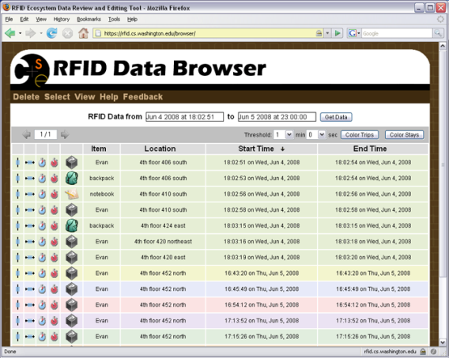
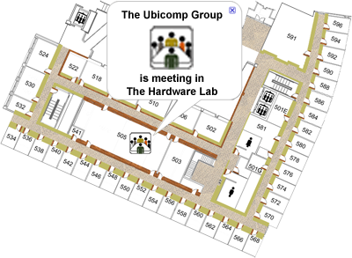
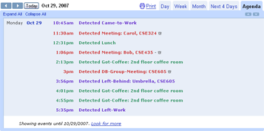
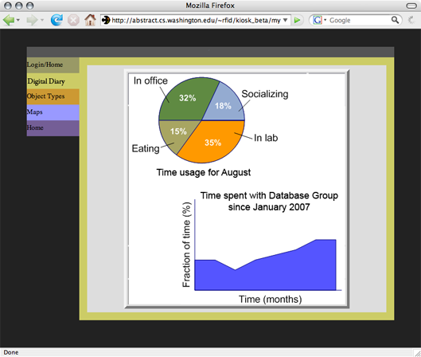
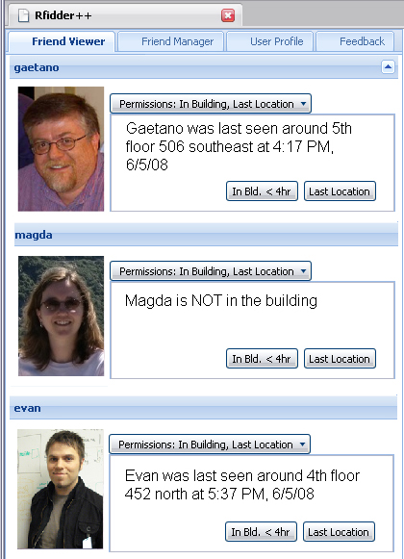
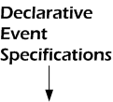
Supported by Cascadia System
Welbourne, E. et al., MobiSys 2008
Context-Aware Social Networking
Ambient Awareness
Friend and Object Finders
Time Use Analysis Tools
RFID-based Reminders

Slide 41
Privacy Tools
Privacy Tools:
Data review tool
Access control tool
Notes:
41

Slide 42
Issue: Basic Insecurity of RFID
Case Study: WA State Enhanced Driver’s License
DHS claims RFID “removes risk of cloning”
Can be cloned easily in less than a second w/cheap device
Can be read more than 75 ft away
Sleeve doesn’t always work, worse when crumpled
# EDL Reads, Week of Apr 27th
Case study credit: Karl Koscher, Ari Juels, Tadayoshi Kohno, Vjekoslav Brajkovic
Notes:
NOTE: DHS Privacy Impact Assessment comment “removes risk of cloning” was in regards to Passcard (which uses same RFID technology as EDL)

